Slide 1
Essay Strategy
- T Prateek Rao (IRTS)
AIR 459 CSE 2020

Slide 2
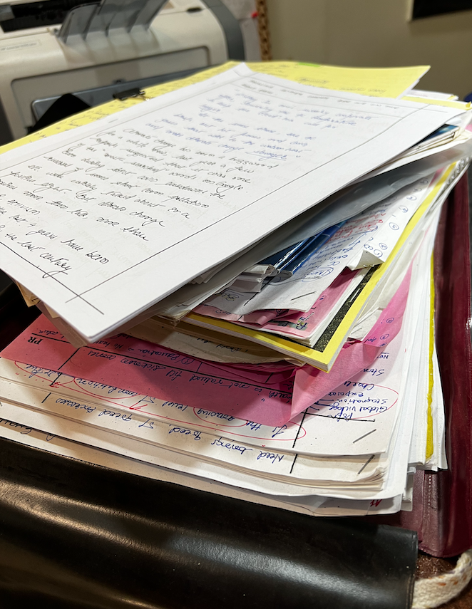
Myths
Good English is a pre requirement
Optional choice helps in essay writing
Need to follow a set pattern
Opening with a bang
Writing everything you know
Dekh lenge !!

Slide 3
Basics
Why to focus on Essay ?
250 marks
Disproportionately higher marks
Lesser effort
Gets missed
What it requires
GS knowledge
Open mind – pop culture, movies
Know your weapons

Slide 4
Basics
Basic Format
Introduction – Body – Conclusion (1-8-1) (Example)
110-120 words per page
5-10 mins to choose both topics
20-25 mins brainstorming each essay (Example)

Slide 5
Basics
Keep close to subject
Arrange in orderly fashion
Write concisely
Effective expression
Exact expression
PS – Think about the examiner !! Wake them up

Slide 6
Sticking to UPSC's demand
Keeping close to the subject
Revisit the prompt/topic after every page - SIGNPOSTING
Be persuasive in your argument
Reaffirm / recall the topic after every argument

Slide 7
Sticking to UPSC's demand
Arrange in orderly fashion & Write concisely
Intro – Body – Conclusion
Body
5-6 ideas
Every idea in 1-2 paragraphs
Every paragraph 3-4 lines maximum.
Every line as simple and short as possible
2-3 Paragraphs per page
After every idea ends, link to next idea (Example)
Balanced analysis and optimism

Slide 8
Sticking to UPSC's demand
Effective expression
YOUnique
Persuasion (cause - effect)
Analytical (this –hence - this)
Complete and Cohesive (Like a story)
Apt / Relevant

Slide 9
Sticking to UPSC's demand
Exact expression
Simple lines
Short lines (Example)
Suitability to the topic
No redundancy

Slide 10
Intro - trailer
Explain the topic – as you understand it
Anecdote (History, Imaginary, Paradox, Conversation)
Quote (Set of quotes), Poetry
Body
Sectoral
PESTLE / SPECHLIH
GS1 – GS2 – Gs3 – GS4
Temporal
Ancient – Medieval – Modern – Indep – Contemporary
Social
Individual – Family – Society – National – Global
What, Why, How, Impact, Efforts, Lacunae, What more
Women, Children, Backward, PWD, LGBTQ, Elderly
5-6 ideas: Let 3-4 be regular, 1-2 USP
Conclusion
Pre conclusion
Wrapping up
Looking forward

Slide 11
Type of Essay
Objective
As mentioned earlier
Philosophical / Abstract
Understanding
Explore dimensions
Break down words
Elaborate and explore the topic
Stakeholder approach

Slide 12
Things to Think About
Test Series
Evaluation – time, who, toppers reccomendations (bowl of salt)
Money
Teacher who is conducting (Their credentials)

Slide 13
Things to Think About
Small is Beautiful
Trends in topics
Short notes on big themes (20-25)
Brainstorm – every other day
Subheadings for Body and Conclusion
1 Essay test per week
Keep seeing topics – from coachings
Read Yojana / Kurukshetra
Read good essays
Try to be more legible than GS

Slide 14
Thank You !!
Blog - https://www.prateekrao.com/upsc-essay
Some resources
https://tetw.org/Greats
https://writingcenter.fas.harvard.edu/pages/essay-structure
Connect
https://www.instagram.com/prateekraot/
https://twitter.com/tprateekrao

Slide 15
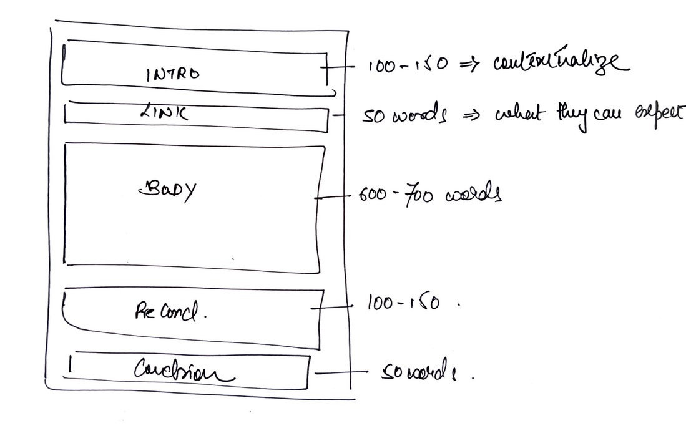

Slide 16
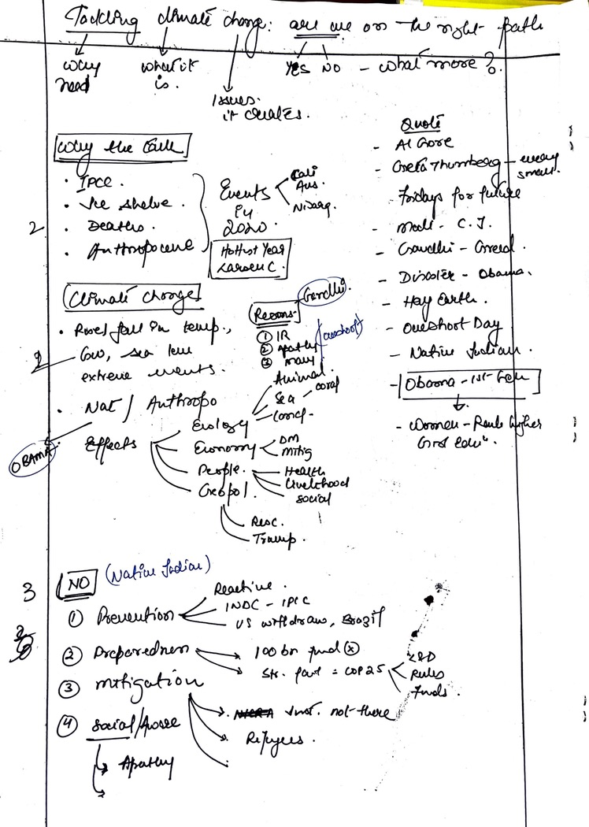
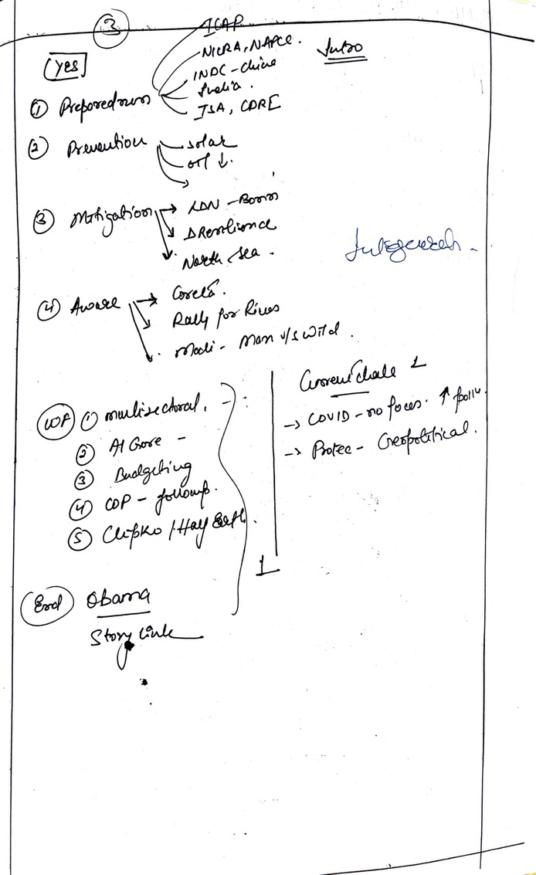

Slide 17
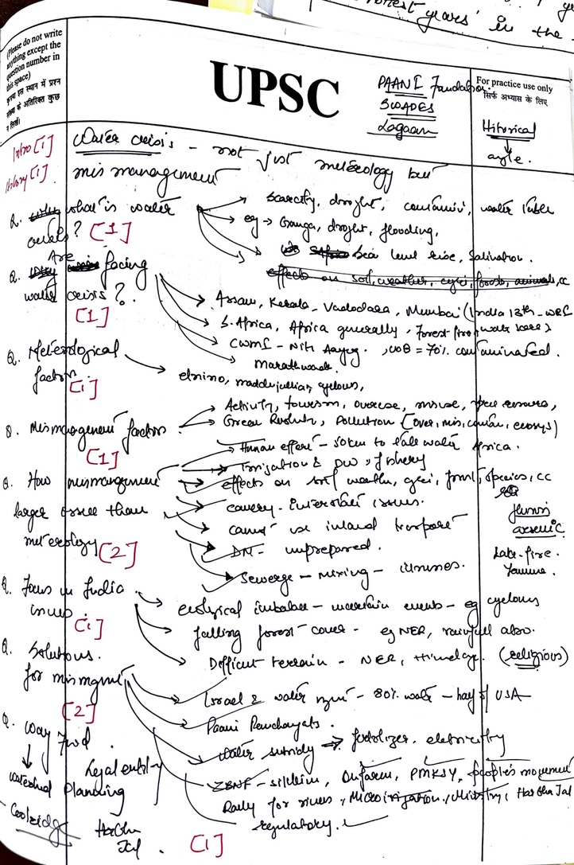

Slide 18
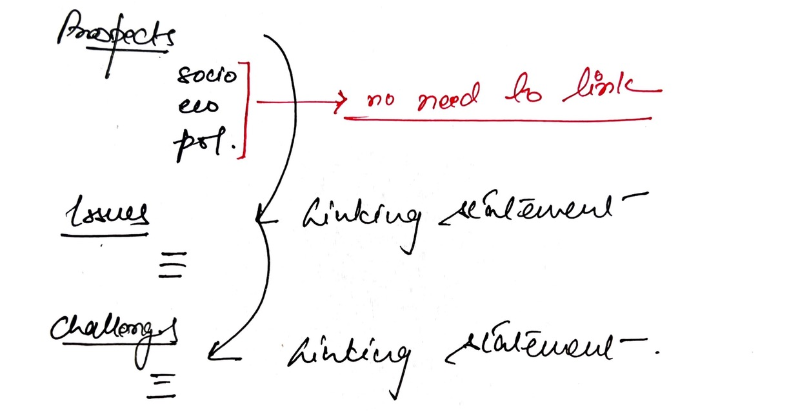

Slide 19
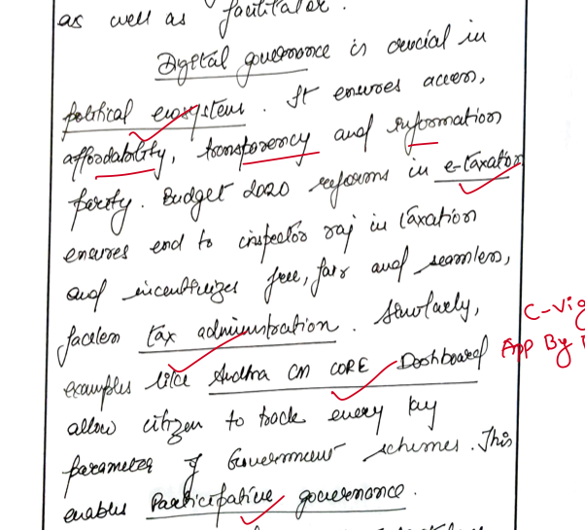

Slide 20
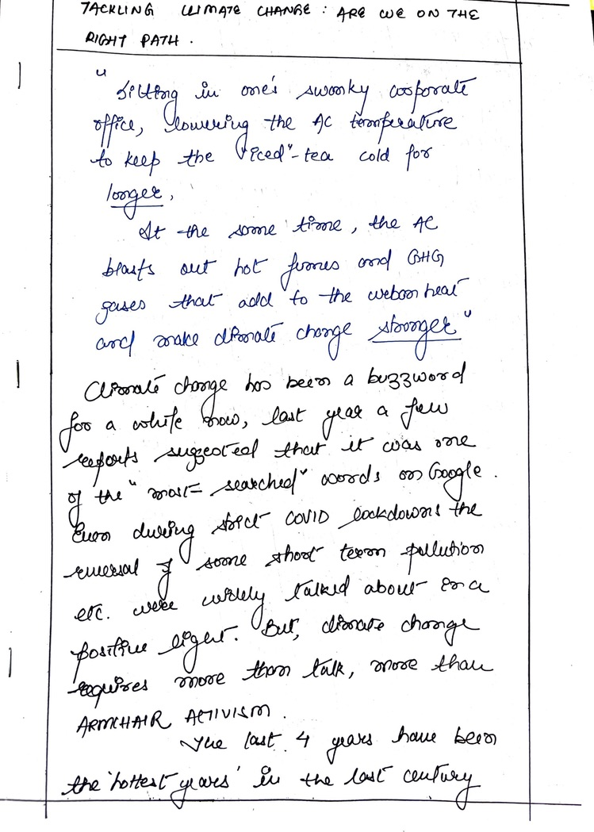

Slide 21
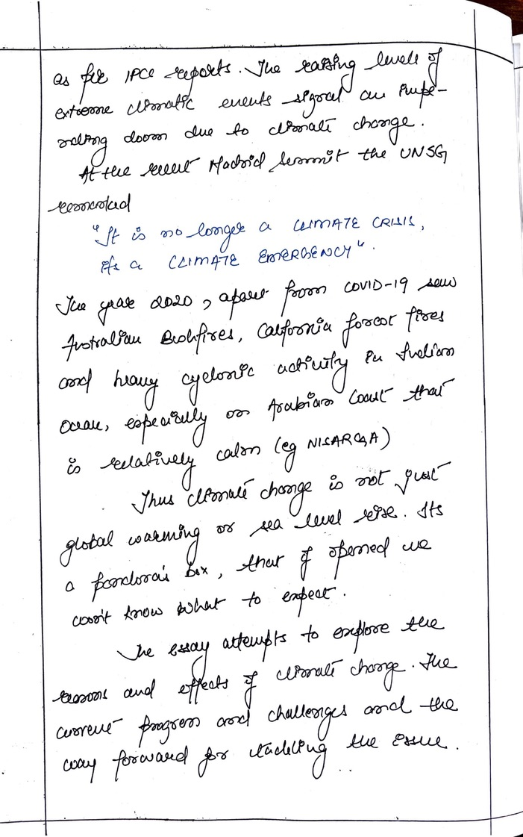

Slide 22
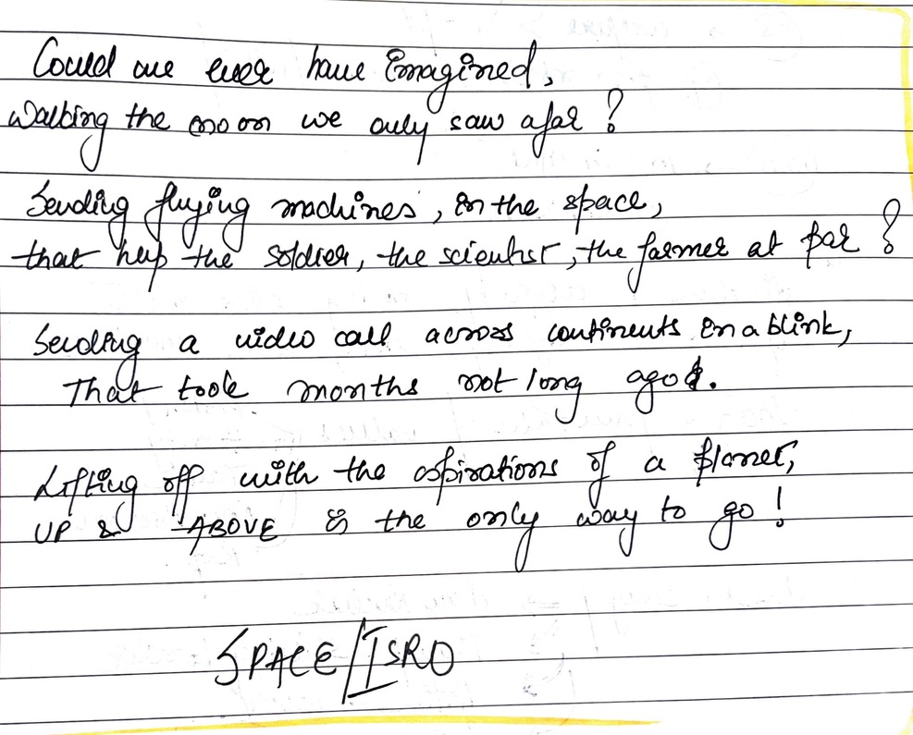

Slide 23
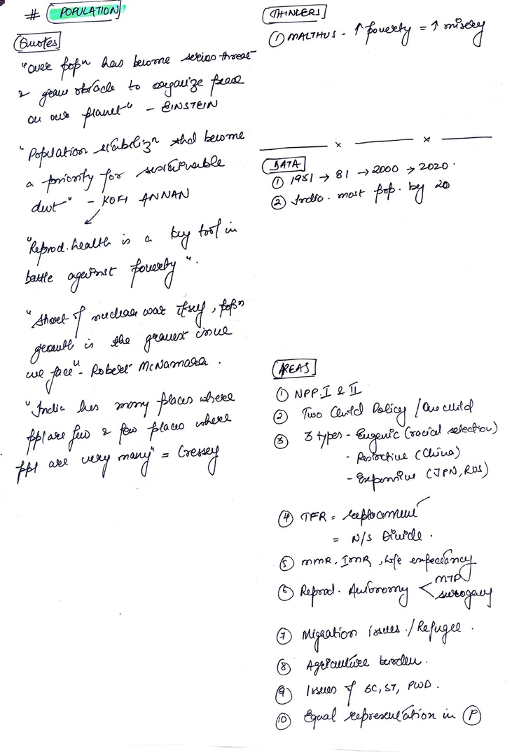
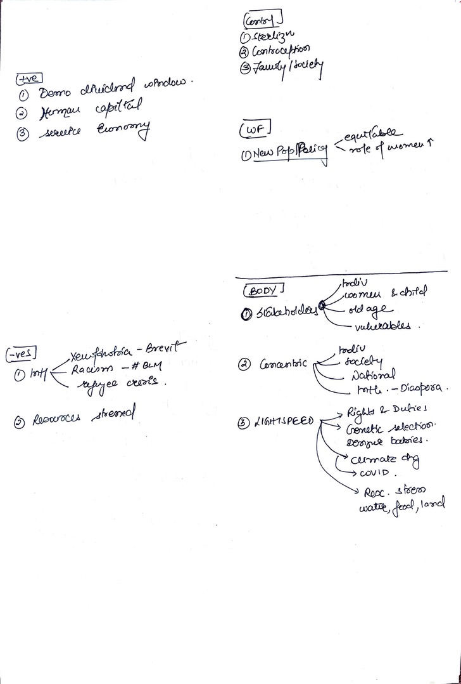

Slide 24
Social Justice
Poverty | Socio-Economic Issues
Women | Indian Culture
Education | Media, Television and Cinema
Children | Environment
Youth | Sustainable Development
Health | Globalization
Political Issues | Urbanization
Components of Democracy like Federalism, Decentralization | International Relations
Judiciary | Science and Technology
Administration | Defence
Economy | Energy
Agriculture, | Security
Rural Development | Current Events

Slide 25
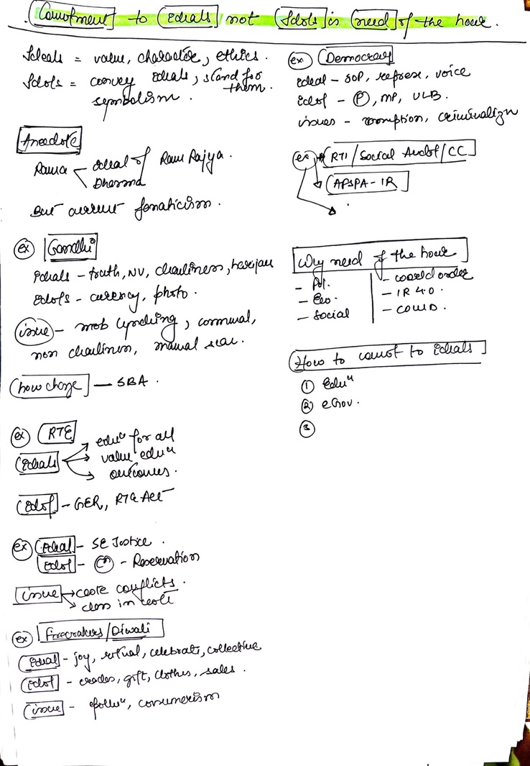

Slide 26
